Slide 1
Raspberry Pi-5 Cryptography Engine

Slide 2
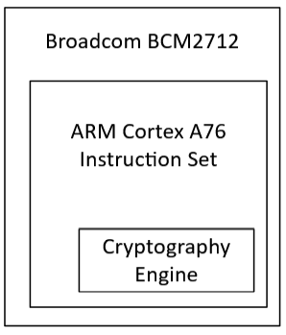
ARM Cortex-A76 CPU on Pi-5
Supports Armv8-A Cryptographic Extension, which adds hardware instructions (advanced SIMD) to accelerate AES encryption/decryption and implements SHA
Hardware accelerated AES and SHA functions are much faster

Slide 3
AES Instructions
SHA instructions
AESE: single round encryption
AESD: single round decryption
AESMC: mix columns
AESIMC: inverse mix columns
SHA1C: hash update (choose)
SHA1P: hash update (parity)
SHA1M: hash update (majority)
SHA1SU0: schedule update 0
SHA1SU1: schedule update 1
SHA256H: hash update 1
SHA256H2: hash update 2
SHA256U0: schedule update 0
SHA256U1: schedule update 1
Other Instructions
PMULL1, PMULL2: Polynomial Multiplication

Slide 4
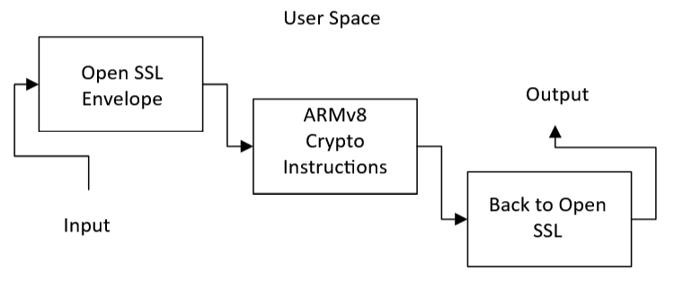
Block Diagram
OpenSSL, Linux Kernel uses the Cortex-A76 Cryptography Extension instructions to complete S-box lookups, round transformations, etc (anything that would usually require a long code-level loop)

Slide 5
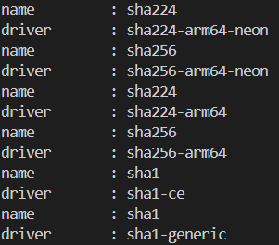
Code for Engine Benchmarks
AES = Encryption Functions

Slide 6
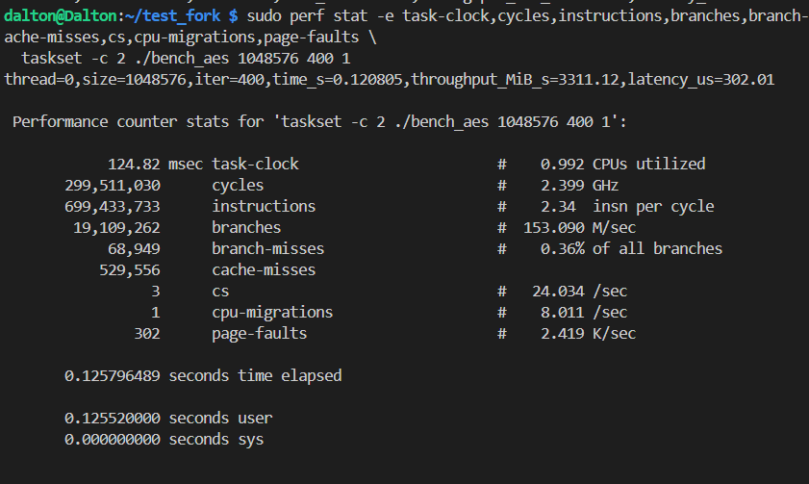
Engine Benchmarks

Slide 7
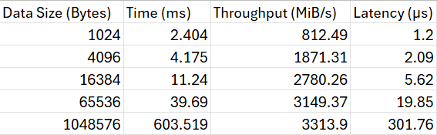
Benchmark Data Table AES

Slide 8
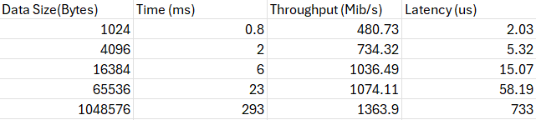
Benchmark Data Table SHA256

Slide 9
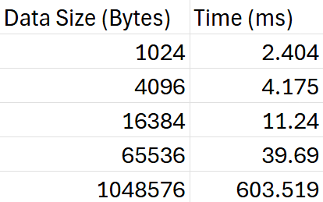
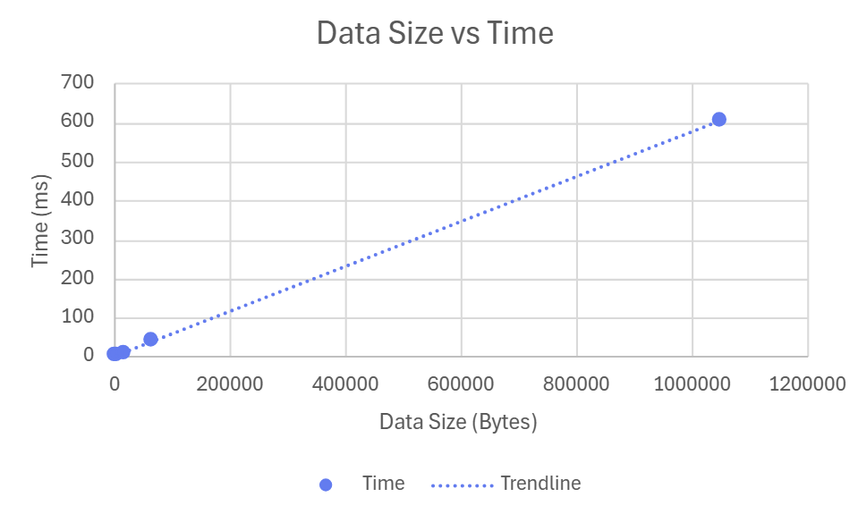
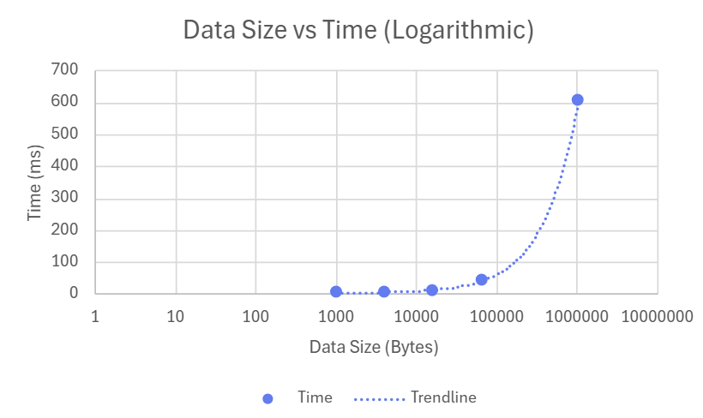
Data Tables & Graphs (Time) AES

Slide 10
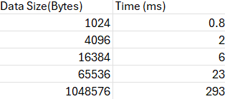
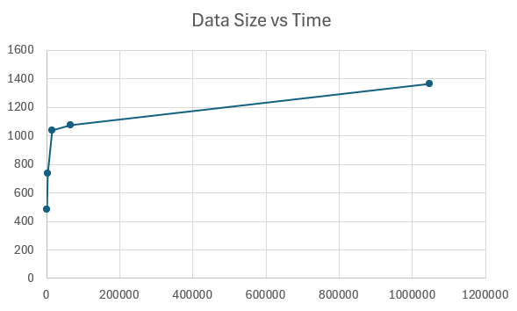
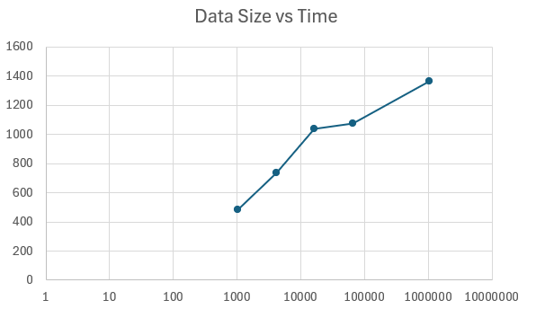
Data Tables & Graphs (Time) SHA256

Slide 11
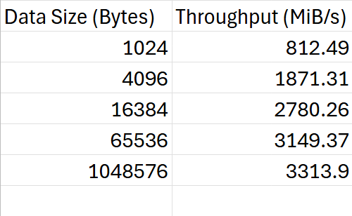
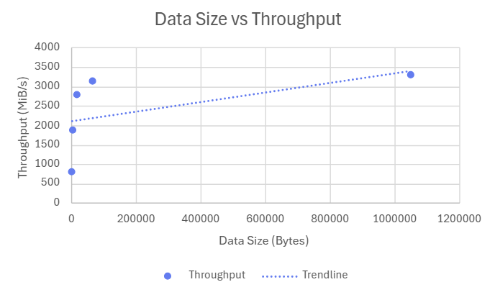
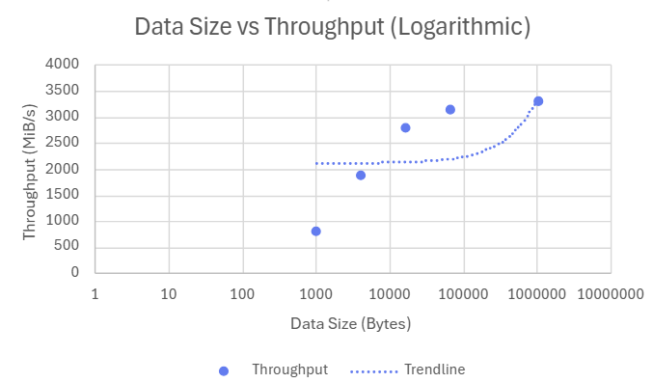
Data Tables & Graphs (Throughput) AES

Slide 12
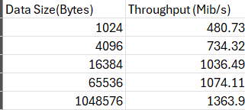
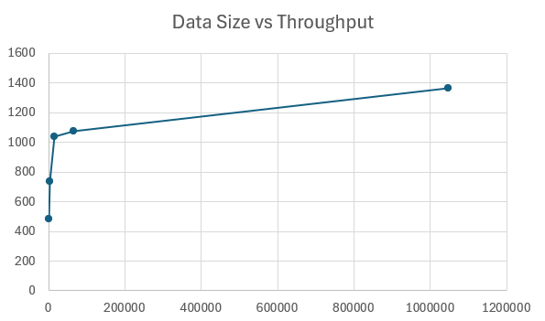
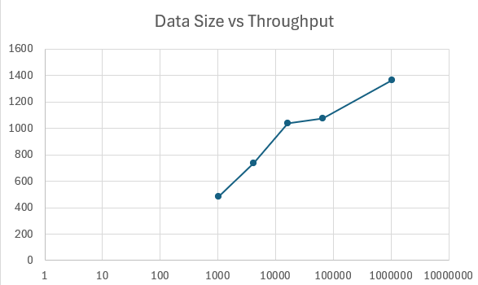
Data Tables & Graphs (Throughput) SHA

Slide 13
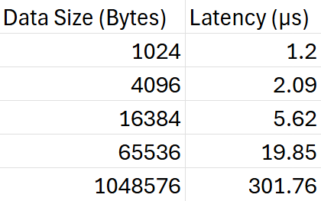
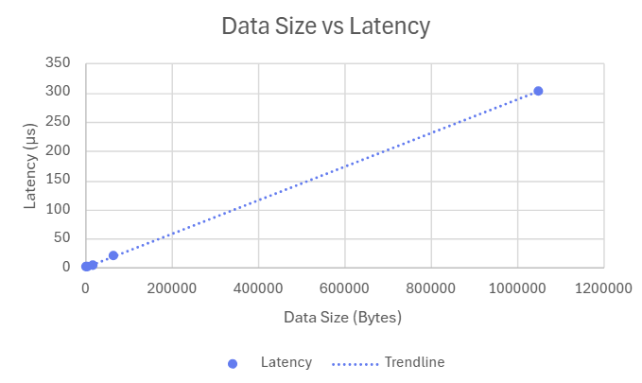
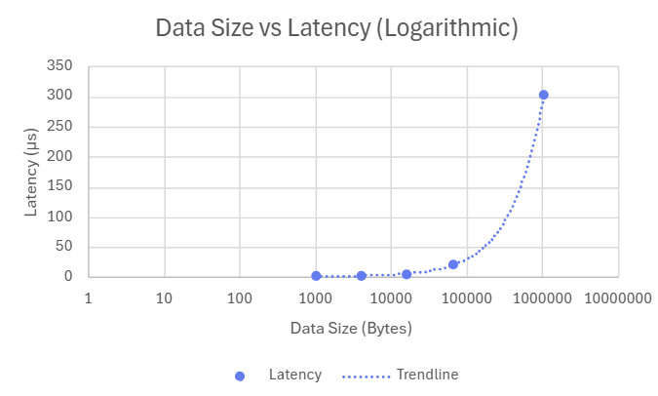
Data Tables & Graphs (Latency) AES

Slide 14
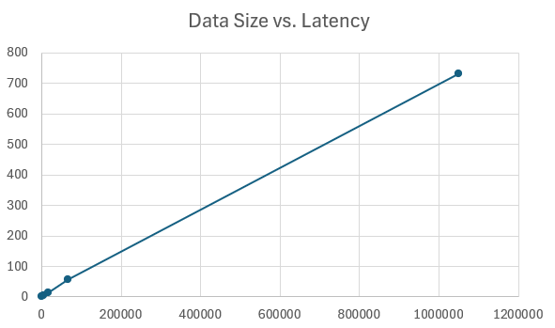
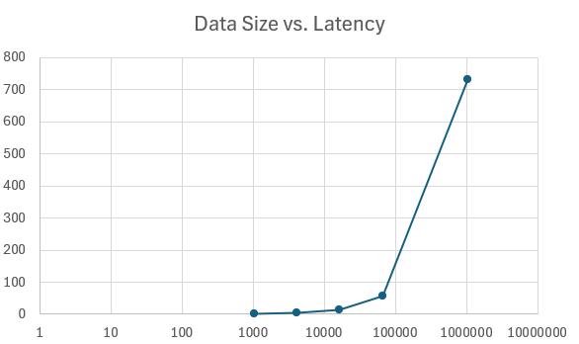
Data Tables & Graphs (Latency) SHA

Slide 15
Data Summary
The results highlight that both EVP and AF_ALG leverage the Pi 5’s hardware-accelerated AES and SHA instructions within the ARM Cortex-A76 processor, while PURE runs entirely in software without using the pi’s hardware acceleration.
The tables show that the Crypto Engine–based methods (EVP and AF_ALG) complete encryption and decryption tasks in much less time, and they also have a much higher throughput (data processed per second), while also being able to maintain lower latency times (faster response times) compared to the PURE approach.

Slide 16
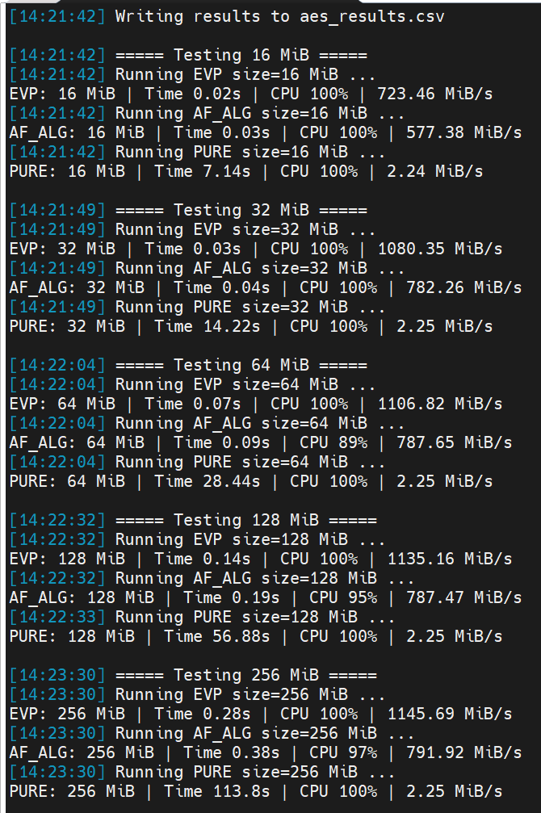
Demonstration Results
EVP: Envelope API Library
Utilizes Crypto-Engine instructions entirely through application
AF_ALG: Address Family Library
Utilizes Crypto-Engine instructions involving the kernel
PURE: Non-Crypto Engine
No Crypto-Engine instruction
Crypto-Engine exceeds x50 non-CE

